Slide 1


K S SCHOOL OF ENGINEERING & MANAGEMENT BENGALURU-560109
D EPARTMENT OF ARTIFICIAL INTELLIGENCE & DATA SCIENCE
DEPARTMENT OF ARTIFICIAL INTELLIGENCE & DATA SCIENCE
(Affiliated to VTU, Belagavi & Approved by AICTE, New Delhi, Accredited by NAAC)
PROJECT WORK (21ADP76)
TITLE: Face anti-Spoofing: Tackling Unseen Presentation Attacks
Project Externals
Group No:7
Date:30/05/2025
NAME USN
UNDER THE GUIDANCE
Ashwini L 1KG21AD001
Laksya Srivastava 1KG21AD022
Ruchitha B J 1KG21AD042
Swarnashree D S 1KG21AD050
Mrs .Madhusmita Mishra
Assistant Professor
Dept, of AI & DS, KSSEM

Slide 2
CONTENTS
Introduction
Problem Statement
Objectives
Methodology of objective1,2,3
Results & Discussion
Conclusion

Slide 3
INTRODUCTION
The proliferation of deepfake content—AI-generated videos that convincingly imitate real human appearances and expressions—has posed a severe threat to multimedia authenticity. These deepfakes can be exploited for misinformation, identity theft, and fraud, creating urgency for robust detection systems. This project aims to develop a hybrid face anti-spoofing system using deep learning, integrating spatial and temporal cues to effectively detect unseen presentation attacks. The model leverages CNN architectures for spatial features and LSTM networks for temporal patterns, offering a comprehensive solution to real-time and robust deepfake detection.

Slide 4
PROBLEM STATEMENT
With the increasing sophistication of deepfake generation techniques, traditional detection methods struggle to identify manipulations in facial expressions and movements. These subtle, high-quality forgeries demand advanced methods that can capture both spatial irregularities and temporal inconsistencies. Thus, the problem is to design a detection system that is robust against unseen presentation attacks such as replay videos, 3D masks, and synthetic manipulations, and can generalize well to real-world scenarios.

Slide 5
OBJECTIVES
Dataset Preparation
Extract frames from real and deepfake videos, detect faces using MTCNN, and organize them into labeled folders for a clean, balanced dataset.
Model Training and Development
Use EfficientNetB0 with dense layers to build a binary classifier. Train with augmented data, applying early stopping and validation checkpoints for optimization.
Evaluation and Front End
Assess performance using accuracy, precision, recall, and F1-score, test on unseen data to ensure robustness.

Slide 6
METHODOLOGY
Objective 1: Dataset Preparation
Frame Extraction: Used OpenCV to extract frames at 1 FPS from each video.
Face Detection: Applied MTCNN to detect and crop face regions from frames.
Preprocessing: Faces were resized to 224×224 pixels and normalized.
Dataset Organization: Separated into ‘real’ and ‘fake’ folders with a 70/30 train-test split.

Slide 7
METHODOLOGY
Objective 2: Model Training and Development
Architecture: EfficientNetB0 used for feature extraction. Dense layers were added for classification.
Loss and Optimizer: Binary cross-entropy as loss function; Adam optimizer for training.
Augmentation: Applied flipping, brightness variation, and zoom to enhance dataset.
Validation Strategy: Early stopping and validation split used to avoid overfitting.

Slide 8
METHODOLOGY
Objective 3: Evaluation and Front-End
Metrics: Accuracy, Precision, Recall, and F1-Score were used for evaluation.
Temporal Analysis: Added LSTM layers for temporal feature modeling.
Front-End: Users can upload video/images; system detects deepfakes and displays results with confidence scores.

Slide 9
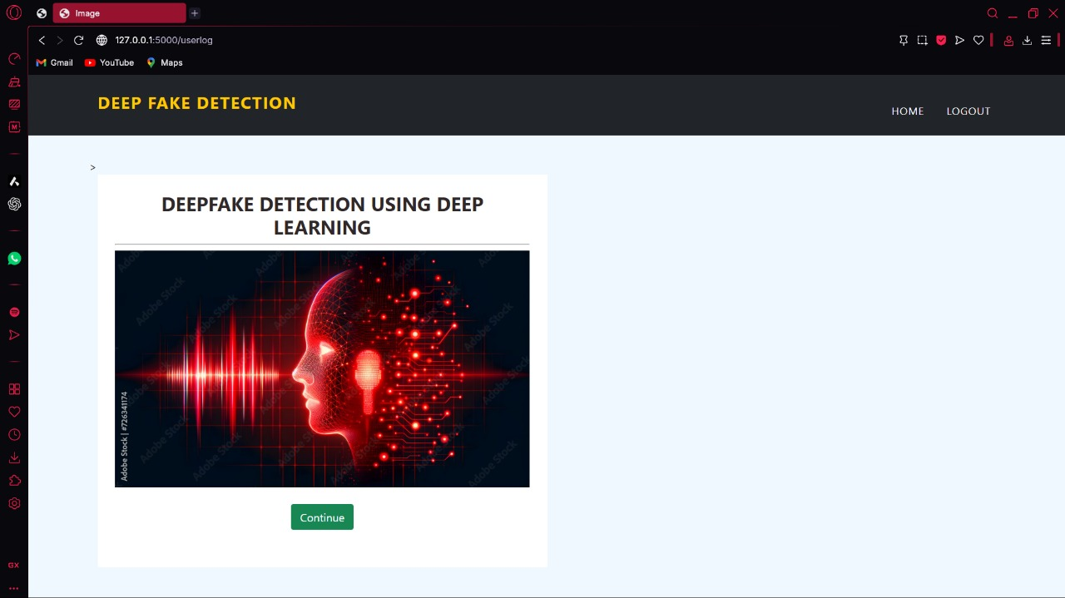
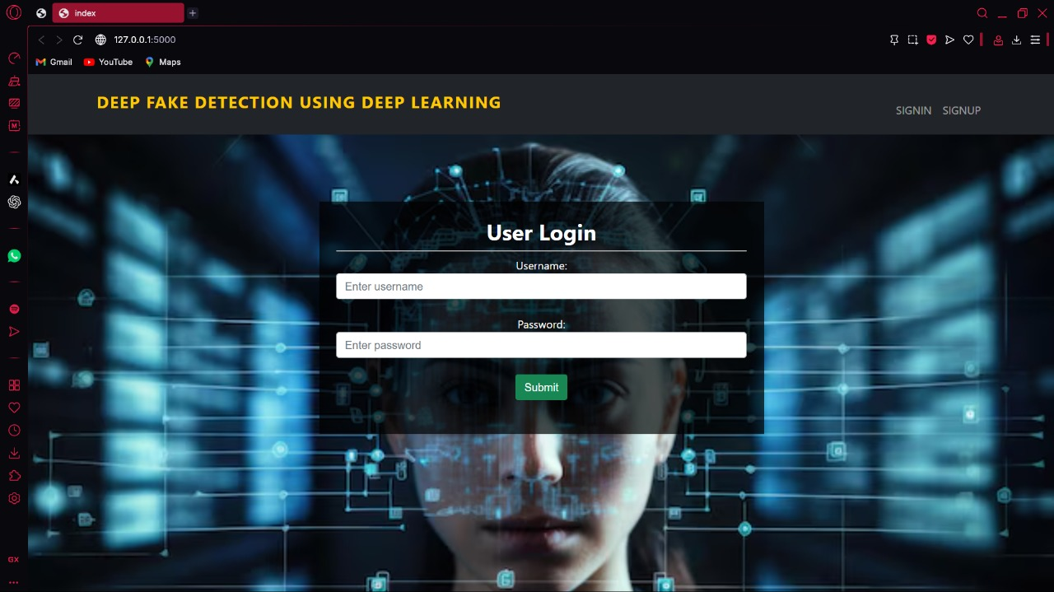

RESULTS AND DISCUSSION
Login Page
User Interface
Registration Page

Slide 10
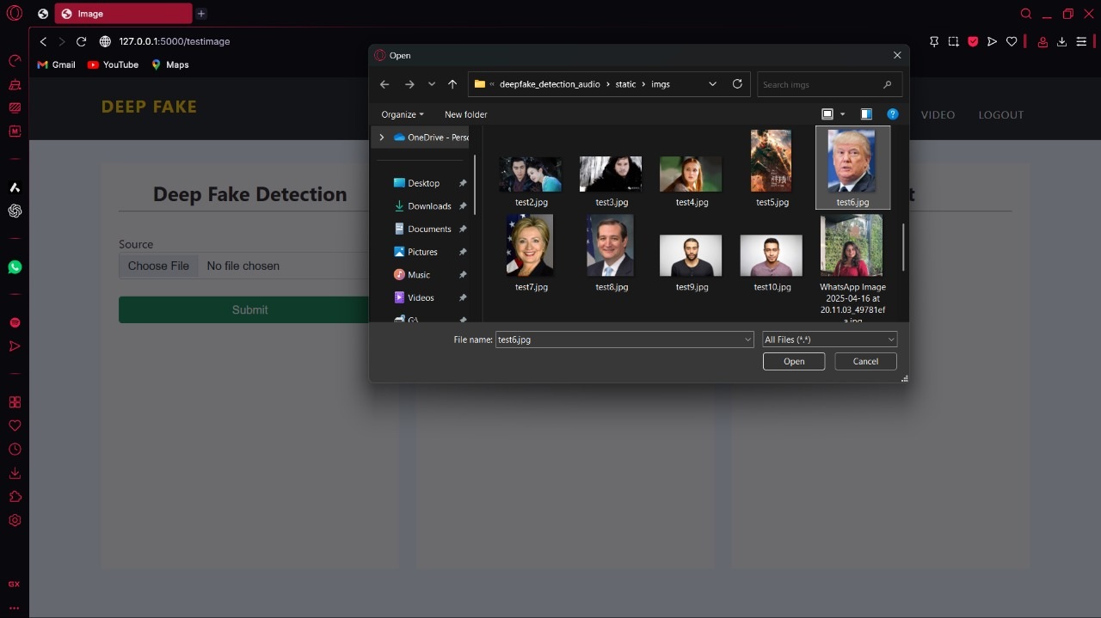
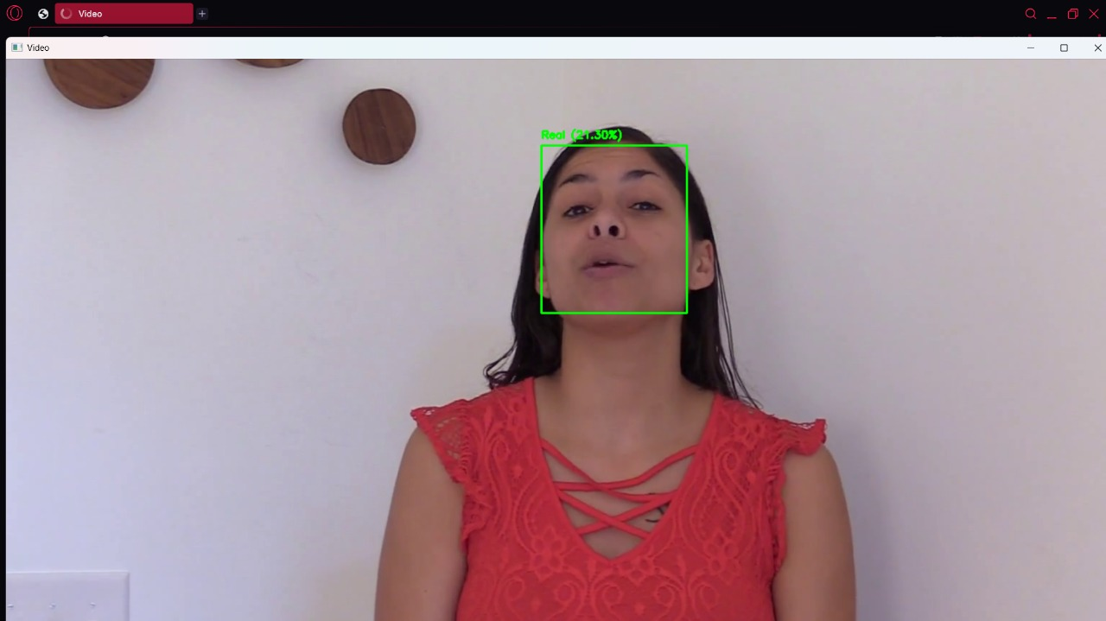
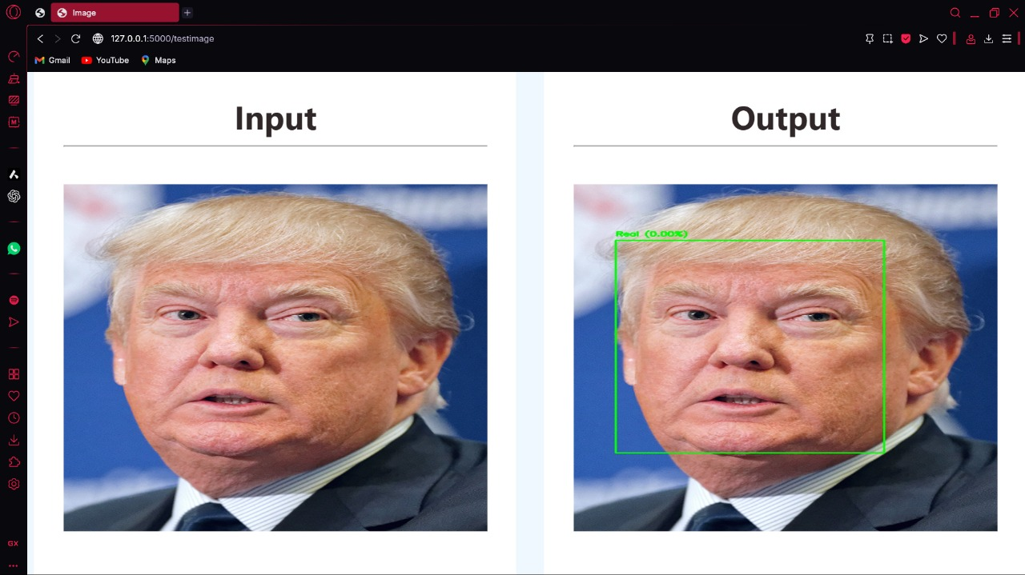
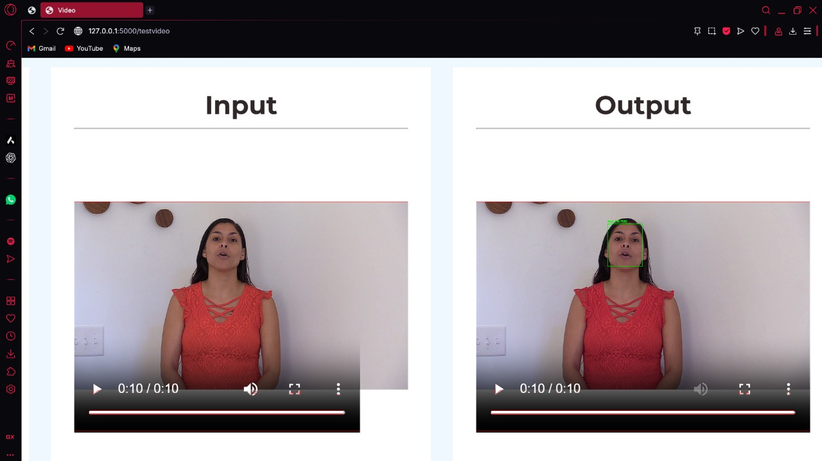
RESULTS AND DISCUSSION
Selecting Images for Prediction
Predicting Video Frame by Frame
Image Result
Video Result

Slide 11
RESULTS AND DISCUSSION
The outcomes of the experimental assessment of the suggested hybrid deepfake detection model demonstrate how well it can differentiate between authentic and manipulated content. The system was able to capture subtle facial manipulations and temporal inconsistencies that are frequently found in deepfake videos by combining the temporal sequence modeling of LSTM networks with the spatial feature extraction capability of ResNet. The model demonstrated its robustness and reliability in a variety of testing scenarios with an overall accuracy of 94.3% when evaluated on benchmark datasets like FaceForensics++ and Celeb-DF.

Slide 12
CONCLUSION
This project presents a deepfake detection system that combines spatial and temporal analysis using CNNs (InceptionResNetV2) and LSTM layers. It effectively detects subtle facial manipulations in videos by analyzing each frame and its sequence. Trained on datasets like FaceForensics and Celeb-Deepfake, the model achieved 94.3% accuracy even under low-light and minimal-motion conditions. With strong precision and recall, this system helps combat digital misinformation and has practical applications in media verification, law enforcement, and content forensics.

Slide 13
THANK YOU

